Slide 1
Kubernetes Training

Slide 2
Introduction

Slide 3
Organization
Labs
3 labs during this training
Done by everyone in shared Kubernetes cluster setup for this training
Everyone has admin rights to this cluster
Please keep within your namespace
Don‘t test the limits of the cluster, we don‘t want to spent half of the training repairing it ☺
All labs and demos as well as these slides are on GitHub:
https://github.com/scholzj/dbg-kubernetes-training

Slide 4
What is Kubernetes

Slide 5
Kubernetes
From Greek
Means helmsman / ship‘s pilot
Steers your ship full of containers ☺
Kubernetes = k8s
System for automated deployment, scaling and management of containerized applications
„A true cloud platform“
Open source (ASL 2.0), governed by Cloud Native Computing Found.
Planet scale, flexible, runs everywhere
Written in Go

Slide 6
Containers
Containers are key to application deployments in Kubernetes
They are the only supported type of workload
Kubernetes supports different container runtimes
Container Runtime Interface = pluggable mechanism for container runtimes
Docker
rkt / rktlet
cri-o / OCI containers (through CRI)
Frakti containers (hypervisor based containers)
Containers allow to run heterogeneous workloads
Everything what can be packed into container can run on Kubernetes

Slide 7
Main features
Self-healing
Restarts applications when they fail
Kills containers which do not respond
Horizontal scaling
Allows scaling of applications up and down
Automatic binpacking
Schedules the containers according to different requirements (density, reliability)
Secrets and Configuration management
Deploys and manages secrets and configurations

Slide 8
Main features
Service discovery and load balancing
Find applications using their DNS names
Load balance across set of containers
Rollouts and rollbacks
Progressively deploy changes or roll them back in case of problems
Storage orchestration
Create storage on supported platforms (AWS, GCP, Gluster, Ceph, …)
Batch execution
Can run long running services but also batch jobs

Slide 9
History
Google has 15 years of experience with running production workloads in containers and had a major role in container development
„Large-scale cluster management at Google with Borg“
„Borg, Omega and Kubernetes“
Kubernetes are not open source version of Borg or Omega, but …
They are built by the same people
They build on the experience from Borg and Omega
Take the good things, improve the bad things
Other frameworks building on Borg heritage (Mesos, CloudFoundry)

Slide 10
Why should you use Kubernetes
Industry standard for containerized deployments
Higher computational density
Better HW utilization
Lower costs
Abstract infrastructure details from applications
Deployed applications don’t care whether the cluster runs on-prem or with different cloud providers
Make writing and running cloud native applications easier
Supports many different types of workloads (long running services, batch jobs, etc.)

Slide 11
Distributions
Kubernetes are open source
Many companies offer „distributions“ of Kubernetes
Might contain enhancements and changes
Often simplify deployment on premise or into different public clouds
Red Hat OpenShift
Tectonic form CoreOs
Rancher
Canonical
VMware
Public cloud providers (Google Container Engine, Microsoft Container Service)

Slide 12
Alternatives
Apache Mesos
Marathon
Apache Aurora
Pivotal Cloud Foundry
Docker Swarm
HashiCorp Nomad
Rancher

Slide 13
Kubernetes cluster

Slide 14
Kubernetes architecture
3 main parts
Master node(s) / control plane
etcd store
Worker nodes
Components can run as regular processes (systemd units) or as Docker images

Slide 15
Kubernetes architecture

Slide 16
Master node(s)
Runs the API server, controller manager and scheduler
API server
Exposes REST API for access to Kubernetes resources
Scheduler
Places containers onto worker nodes
Controller Manager
Runs in loops and reconciles the actual state of the cluster with the expected state
Either in standalone mode or in HA mode with elected leaders
In some installations it might run also other (system) components

Slide 17
etcd
Used to store the cluster state
Distributed key-value store
Data are replicated across instances
Leader is elected from the nodes
etcd can be used to gain access to the cluster and therefore is needs to be secured / protected
Can run on separate hosts or on the master nodes
Accessed only by the API manager, not by any other components or by the deployed applications

Slide 18
Worker nodes
Used to run deployed applications
Kubelet
Controls that the correct containers are running
Proxy
Manages network connectivity between containers
Kubelet and Proxy are running on each worker node

Slide 19
Kubernetes architecture

Slide 20
Networking
Uses a network bridge to connect to the network
Every computing unit (Pod) has its own IP address
Avoid problems with port conflicts between different computing units
Computing unit = Pod (group of related containers)
The network setup can be achieved using SDN or physical network
Several different SDNs:
Weave, Calico, Flannel
Kubernetes have their own Network Policies
Kubernetes support only ingress network policies
Some SDNs like Calico support also egress network policies

Slide 21
Demo 1: Kubernetes components
Notes:
Log into one of the master hosts and show the running components
Log into one of the workers and show the components running on the workers

Slide 22
Kubernetes installation

Slide 23
Installation
Manually
Prepare physical / virtual machines
Install the Kubernetes software
Wire the different components together
Different tools to simplify installation
Often integrated directly into public clouds
Different deployments
Single node deployments (for development)
Single node etcd, single node master and multiple workers
Single node etcd, HA master and multiple workers
HA etcd, HA master and multiple workers
Different distributions might have their own deployment tools

Slide 24
Public clouds
Google Container Engine (GKE)
Part of Google Cloud
Easiest way how to get started with Kubernetes
Setup the cluster with few clicks from the Cloud Console or from the gcloud command line tool
Microsoft container Service
Part of Microsoft Azure cloud
OpenShift Online
Based on OpenShift

Slide 25
Tools
Kops
Cluster deployment into Amazon AWS
Can generate Terraform templates
Planned to support also other clouds (GCP)
Kargo
Based on Ansible
Can deploy production ready cluster to bare metal and many different clouds
kube-aws
Uses Amazon CloudFormation
Deploys Kubernetes in AWS using CoreOS
kubeadm
Helps with Kubernetes installation on existing machines
Expected to be part of something „bigger“

Slide 26
Demo 2: Training cluster in AWS
Notes:
Log into Amazon AWS
Show the bastion, master and worker EC2 hosts
Show the autoscaling groups keeping the hosts alive

Slide 27
Development installations
Minikube
Single node installation of Kubernetes
Runs in VM on Linux or OS X
Part of Kubernetes project
Hyperkube
Kubernetes in single Binary
Runs a kubelet and lets it deploy all other Kubernetes components

Slide 28
Demo 3: minikube
Notes:
* Start minikube using `minikube start`
* Show minikube status with `minikube status`
* Open the dashboard with `minikube dashboard`
* Mention docker integration
* Mention services
* Stop minikube `minikube stop`
* Delete minikube `minikube delete`

Slide 29
Add-ons
Add-ons provide some enhanced functionality to the cluster
Not required, but recommended
DNS service
Heapster
Monitoring of HW resources (CPU, RAM)
Can forward the data into resource monitoring systems (Influx, Grafana, …)
Can be used for auto-scaling
Fluentd
Used to collect logs from running containers
Can forward the logs into ElasticSearch etc.

Slide 30
How to try Kubernetes?
Use Minikube on localhost
https://github.com/kubernetes/minikube
Use Kops to deploy Kubernetes into our AWS Sandbox:
https://github.com/scholzj/aws-k8s-kops-ansible

Slide 31
Accessing Kubernetes

Slide 32
Kubernetes API
Kubernetes provides REST API
API can be used to access all Kubernetes resources
Split into API groups
Some resources are in the core API, e.g. api/v1
Some are part of beta or alpha extensions, e.g. api/extensions/v1beta1
Every resource has
Kind, API version, Metadata, Spec
Uses OpenAPI / Swagger to describe the API
Can be accessed directly or through provided tools

Slide 33
Demo 4: API
Notes:
Start the proxy
Use curl o show some parts of the API

Slide 34
kubectl
CLI tool for working with the Kubernetes API
Can be used to create, list or delete resources
Communicates via the REST API
Advanced usage
Proxy connections between cluster and localhost
Get latest logs
Connect into running containers

Slide 35
kubectl
Configuration is stored locally
„cluster“ configuration contains the API endpoint etc.
„credentials“ configuration contains the configuration of the user
„context“ links one cluster and one credentials object
Current context is used as default
„—context“ can be used to overwrite the current context

Slide 36
Demo 5: kubectl
Notes:
Show `kubectl help`
Show `kubectl config view` to show the configuration
Show `kubectl config -h` and show the `set-context`, `set-credentials`, `set-context` and `use-context`
Show `kubectl cluster-info`
Show `kubectl get componentstatuses`
List the master and worker nodes using `kubectl get nodes`
Show `kubectl proxy`, explain what it does and say that it was used before in the API demo

Slide 37
Kubernetes Dashboard
Browser based UI
Monitor and manage resources deployed into the cluster
Monitor and manage the cluster it self
Monitor resources consumed by deployed applications
Runs as any other application deployed into Kubernetes

Slide 38
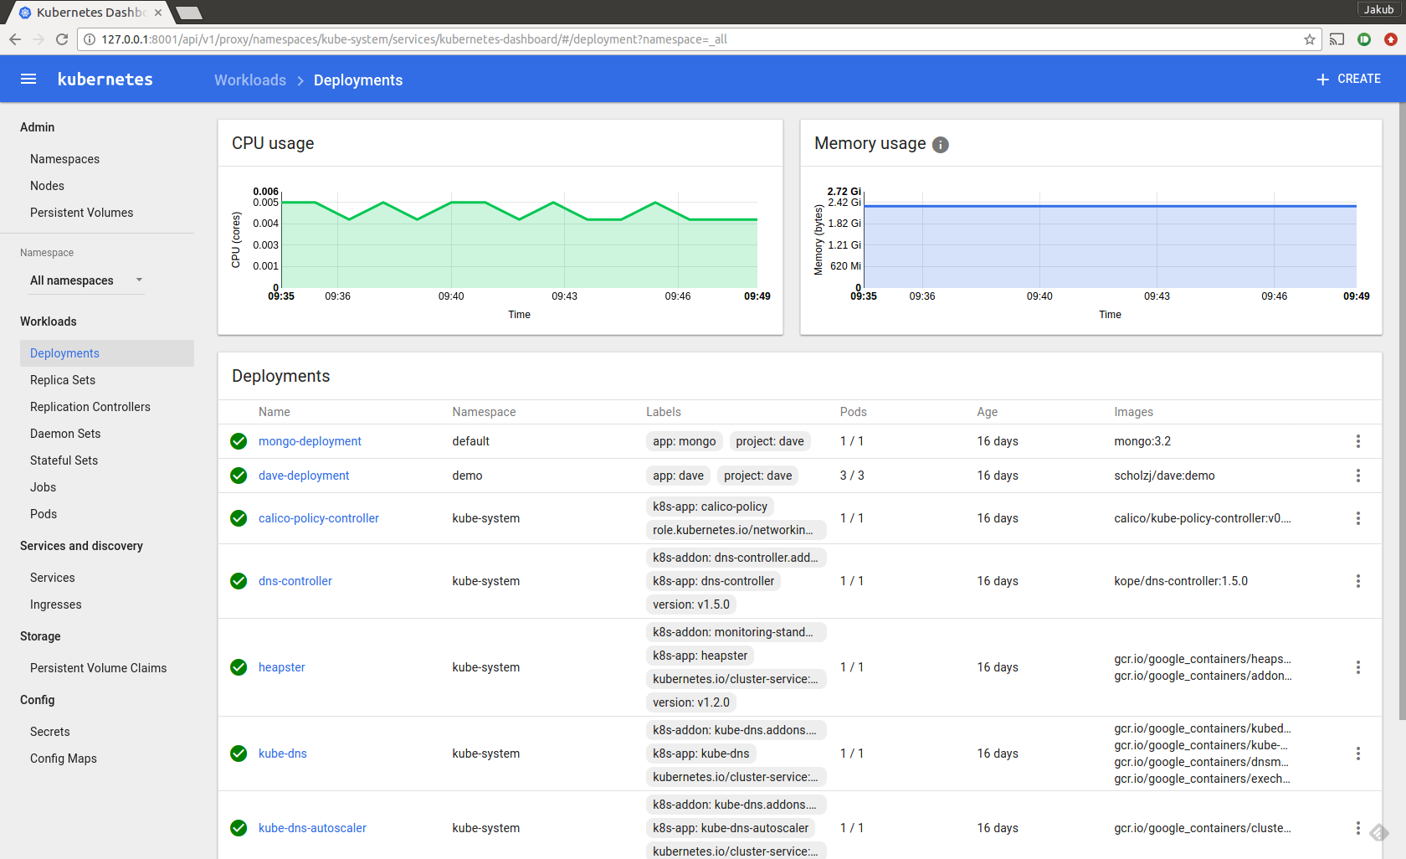
Kubernetes Dashboard

Slide 39
Demo 6: Kubernetes Dashboard
Notes:
Run `kubectl proxy`
Open http://localhost:8001/ui in your browser
Give a walktrough the Dashboard ... show nodes, etc.

Slide 40
Lab 1: Accessing Kubernetes cluster
http://jsch.cz/k8slab1

Slide 41
Kubernetes Resources

Slide 42
Resources
Kubernetes API is built out of resources
There are many different resource types
Each resource has ist own purpose
The different resource types work together like Lego bricks
To deploy an application, usually several different resources are used

Slide 43
Resources

Slide 44
Namespaces

Slide 45
Namespaces
Most resources are split between namespaces
Avoid naming conflicts
Isolation between different applications
Resource limits
„kube-system“ namespace contains the system components
„default“ namespace is used unless another namespace is specified
Managed through the API
kubectl get ns
kubectl create ns schojak
Use the „--namespace=schojak“ option to list resources from different namespaces

Slide 46
Demo 7: Namespaces
Notes:
# Demo 7: Namespaces
* Create a namespace using `kubectl`:
```
kubectl create namespace schojak
```
* List the namespaces:
```
kubectl get namespaces
```
* List pods from the new namespace
```
kubectl --namespace schojak get pods
```
* List pods from the `kube-system` namespace
```
kubectl --namespace kube-system get pods
```
* Show how to create namespace from YAML file
```
kubectl create -f namespace.yaml
```
* Show how to work with namespaces in Dashboard
* Show how to delete the namespace
```
kubectl delete namespace schojak2
```

Slide 47
Labels
All resources in Kubernetes have labels
Labels are used not only to identify the individual resources, but also to establish links between them and many other tricks

Slide 48
Pods

Slide 49
Pods
Smallest computing unit in Kubernetes
Every pod has its own IP address
Contains one or more containers
All containers from one Pod instance are running on the same node
Containers in one Pod can easily communicate, share data and resources
Containers share Pod‘s IP address and one port space
Why should you run more container in single pod
Tight coupling between applications
Logging and monitoring adapters
Proxies, bridges and adapters
Local cache managers
File loaders

Slide 50
Pods

Slide 51
Pods
Specified using YAML or JSON
API version and resource type
Pod name and labels
Might specify namespace
Containers and their ports
Resource limits
Volumes
apiVersion: v1
kind: Pod
metadata:
name: redis-Django
labels:
app: web
spec:
containers:
- name: key-value-store
image: redis
ports:
- containerPort: 6379
- name: frontend
image: django
ports:
- containerPort: 8000

Slide 52
Pods
Not durable on their own
When Pod is deleted, applications inside receive TERM signal and have 30 seconds to stop
Pods are not automatically restarted
Health and readiness probes:
HTTP GET
TCP SOCKET
Exec

Slide 53
Pods
Init containers
Are run before the main containers are started
Can be used to prepare the environment
Generate config files
Download data
Resource management
Requests and limits
CPU and Memory
Environment variables
Used to configure the container(s)

Slide 54
Demo 8: Pods & Labels

Slide 55
Replication controllers
Ensures that Pods are running in required number of replicas / instances
Starts new Pods if needed
The RC specification contains a Pod template which is used to create the Pods
Pods created by RC have no fixed names and cannot be easily addressed directly
Rolling updates supported only from client side
Deprecated

Slide 56
Replication controllers
apiVersion: v1
kind: ReplicationController
metadata:
name: nginx
spec:
replicas: 3
selector:
app: nginx
template:
metadata:
name: nginx
labels:
app: nginx
spec:
containers:
- name: nginx
image: nginx
ports:
- containerPort: 80

Slide 57
Replica Sets

Slide 58
Replica Sets
„Next generation“ Replication Controller
Improved selectors over replication controllers
Usually used not independently but through Deployments

Slide 59
Deployments

Slide 60
Deployments
Usually used to deploy your application
Instead of using Pods, Replica controllers or Replica Sets directly
Supports server-side rolling updates and canary deployments
Creates ReplicaSets which create Pods

Slide 61
Deployments

Slide 62
Deployments
apiVersion: extensions/v1beta1
kind: Deployment
metadata:
name: nginx-deployment
spec:
replicas: 3
template:
metadata:
labels:
app: nginx
spec:
containers:
- name: nginx
image: nginx:1.7.9
ports:
- containerPort: 80

Slide 63
Demo 9: Deployments
Notes:
# Demo 9: Deployments
* Create deployment `kubectl --namespace schojak create -f deployment.yaml`
* Show the running pod using `kubectl --namespace schojak get pods -l app=kuard`
* Scale the replica from command line `kubectl --namespace schojak scale deployment/kuard --replicas 3`
* Show that 3 replicas are running using `kubectl --namespace schojak get pods -l app=kuard`
* Show how to configure replicas in YAML and how to do it in Dashboard
* Delete the pods and show that a new ones are started by the deployment:
```
kubectl --namespace schojak get pods -l app=kuard --watch
kubectl --namespace schojak delete pods -l app=kuard
```
* Show rolling update
* Scale the deployment to 10 replica `kubectl --namespace schojak scale deployment/kuard --replicas 10`
* Update the image version `kubectl --namespace schojak set image deployment/kuard kuard=gcr.io/kuar-demo/kuard-amd64:3`
* Watch the rollout `kubectl --namespace schojak rollout status deployment/kuard --watch`
* Do update which will fail `kubectl --namespace schojak set image deployment/kuard kuard=gcr.io/kuar-demo/kuard-amd64:4`
* Watch the rollout `kubectl --namespace schojak rollout status deployment/kuard --watch`
* Check the revision history `kubectl --namespace schojak rollout history deployment/kuard`
* Rollback to previous revision `kubectl --namespace schojak rollout undo deployment/kuard --to-revision 4`
* Scale down the deployment `kubectl --namespace schojak scale deployment/kuard --replicas 3`

Slide 64
ConfigMaps

Slide 65
ConfigMaps
Can be created using kubectl
From YAML / JSON files
Generated from files / directories which should be in the config map

Slide 66
ConfigMaps
Can be mapped to environment variables
env:
- name: MY_SPECIAL_VARIABLE
valueFrom:
configMapKeyRef:
name: my-config-map
key: my-key

Slide 67
ConfigMaps
Or mapped to a volume inside the Pod
volumeMounts:
- name: config-volume
mountPath: /etc/config
…
volumes:
- name: config-volume
configMap:
name: my-config-map

Slide 68
Demo 10: ConfigMap
Notes:
* Show the YAML file with Config Map
* Create the config map in Kubernetes `kubectl --namespace schojak create -f configmap.yaml`
* Show the directory with the config files
* Create a config map from the directors using `kubectl --namespace schojak create configmap file-based --from-file=config/`
* Show how to use the config map in deployment
* Redeploy kuard to show the `kubectl --namespace schojak apply -f deployment.yaml`
* Show the env. variables in kuard as well ad the files

Slide 69
Secrets

Slide 70
Secrets
Used to store secrets
Passwords
Private keys
Assigned to the node only when some Pod needs them
Deleted together with the Pod
Stored in the etcd server
Creation and usage very similar to config maps

Slide 71
Demo 11: Secrets
Notes:
* Show the YAML file with Secret
* Create the secret in Kubernetes `kubectl --namespace schojak create -f secret.yaml`
* Show the directory with the config files
* Create a secret from the directors using `kubectl --namespace schojak create secret generic file-based --from-file=certificates/`
* Show how to use the secret in deployment* Redeploy kuard to show the `kubectl --namespace schojak apply -f deployment.yaml`
* Show the env. variables in kuard as well ad the files

Slide 72
Services

Slide 73
Services
Containers are running within Pods
Pods created by RCs / Deployments don‘t have stable names / IP addresses
Cannot be addressed from other applications
Service targets set of one or more pods (based on Label selector)
Maps Pod / Container ports to a service ports
Exposes the underlying service for discovery
Provide stable address using IP address / DNS name
DNS names are based on „service-name.namespace“ pattern
Service hosts and ports are also exposed via environment variables

Slide 74
Services
Different service types
ClusterIP
Assigns internal IP address / hostname
Accessible only from within the Kubernetes cluster
NodePort
Binds the service to the Node where the Pod is running
Usually used only for special purposes (debugging)
LoadBalancer
Creates a load balancer which is accessible from outside
Work usually on public cloud (AWS, GCP), where it creates its native load balancer

Slide 75
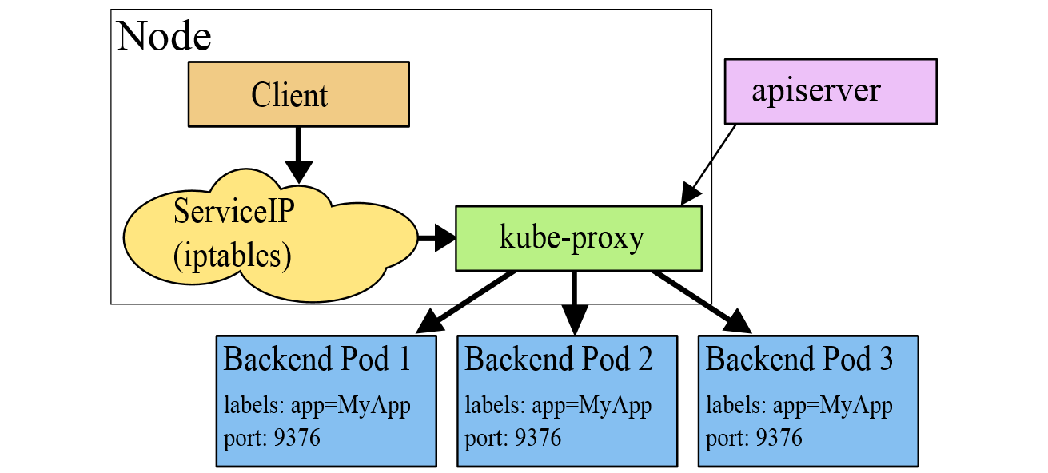
Services
Source: kubernetes.io

Slide 76
Demo 12: Services
Notes:
Show the YAML file with Service
* Create the service in Kubernetes `kubectl --namespace schojak create -f service.yaml`
* Check the service in dashboard
* Open the service DNS name and show how it round robins between the different pods
* Show the dns name in kuard
* Show the env. variables in kuard

Slide 77
Microservices deployment

Slide 78
Lab 2: My first application
http://jsch.cz/k8slab2

Slide 79
Volumes
Volumes map disks to Pods
Each volume has name and type
volumes:
- name: my-vol
emptyDir: {}
Volumes can be mounted into containers using VolumeMounts
One volume can be mounted to multiple containers in the same pods
Mount paths can be different for each container
volumeMounts:
- mounthPath: /my/volume
name: my-vol

Slide 80
Volumes
Different volume types:
emptyDir
Empty directory on the node where the pod runs, which is deleted when the Pod dies
hostPath
Path on the node where the pod is running, which survives the Pod deletion
NFS
iSCSI
CephFS
GlusterFS
AWS/GCP disks
Persistent Volume Claims
etc.

Slide 81
Persistent Volumes
Abstracts the storage for persisitent disks
Used to map Kubernetes volumes to disk as provided by infrastructure (AWS, GCP, Gluster)
Thanks to the abstraction, your application doesn`t care where the Kubernetes cluster runs
Maps against specific physical / virtual disk
The persistent volume it self is not portable
But all resources referring to it by its name are portable
Reclaim policy
What happens when the disk is returned … should it be deleted or retained?

Slide 82
Persistent Volumes
apiVersion: v1
kind: PersistentVolume
metadata:
name: mongo-volume
labels:
type: local
spec:
capacity:
storage: 10Gi
accessModes:
- ReadWriteOnce
awsElasticBlockStore:
volumeID: vol-d371e406
fsType: ext4
persistentVolumeReclaimPolicy: Delete

Slide 83
Storage Class
Used to dynamically provision Persistent Volumes
Specifies the type of the disk (e.g. magnetic, SSD, IOPS)
kind: StorageClass
apiVersion: storage.k8s.io/v1beta1
metadata:
name: ssd
provisioner: kubernetes.io/aws-ebs
parameters:
type: gp2

Slide 84
Persistent Volume Claims
Used to claim Persistent Volume
Used within a pod
Reserves (claims) the persistent volume
Can be used in combination with StorageClass to dynamically provision volumes
Claims are referred to by volumes inside the Pods

Slide 85
Persistent Volume Claims
kind: PersistentVolumeClaim
apiVersion: v1
metadata:
name: mongo-storage
namespace: database
annotations:
volume.beta.kubernetes.io/storage-class: "ssd"
labels:
name: mongo-storage
spec:
accessModes:
- ReadWriteOnce
resources:
requests:
storage: 10Gi

Slide 86
Demo 13: Persistent Volumes
Notes:
* Deploy the PVC YAML file `kubectl --namespace schojak create -f pvc.yaml`
* Show the PVC and PV in dashboard
* Show the new volume in AWS
* Add the volume to the Deployment
* Show the volume in Kuard

Slide 87
Lab 3: Multi-tier application
http://jsch.cz/k8slab3

Slide 88
DaemonSets
Similar to Replication Controllers
Run single Pod on every single node of the cluster
Use cases:
Network pods
Log collectors
Storage daemons
Monitoring daemons

Slide 89
Demo 14: DeamonSets
Notes:
Log into Dashboard
Show calico running as a daemon set on every node

Slide 90
StatefulSets
Running stateful applications is hard!
Stateless applications have no need to address replicas individually
Treat them as cattle and use deployment
Stateful applications often need to address replicas
Treat them as pets
Deployments name their pods randomly and make them not addressable
Alternative to deployment of stateful applications using several separate deployments with single replica are Stateful Sets

Slide 91
StatefulSets
Named PetSets before Kubernetes 1.5
Stateful sets treat pods as pets
Each pods is created with index instead of random name
Index doesn‘t change when you move to different node or restart the pod
Thanks to the fixed index, pods have fixed addresses and can be used for clustering

Slide 92
Demo 15: StatefulSets
Notes:
* Show the stateful set YAML, with the PVC tamplates
* Create the stateful set using `kubectl --namespace schojak create -f statefulset.yaml`
* Show the volumes and the fixed name pods in the Dashboard

Slide 93
Jobs
Provide support for batch jobs
Job starts a Pod and monitors it
If the Pod fails it is restarted
If the pod completes the Job completes as well
Jobs can run Pods in parallel replicas

Slide 94
Jobs
apiVersion: batch/v1
kind: Job
metadata:
name: pi
spec:
template:
metadata:
name: pi
spec:
containers:
- name: pi
image: perl
command: ["perl", "-Mbignum=bpi", "-wle", "print bpi(2000)"]
restartPolicy: Never

Slide 95
Demo 16: Jobs
Notes:
* Show the YAML file * Create the job using `kubectl --namespace schojak create -f job.yaml` * Show the Job in Dashboard and show the results

Slide 96
Ingress
Load balancer type service works only on Layer 4 (TCP)
Ingress stands between the internet and the internal services
Works as a Layer 7 load balancer
Understands HTTP
SSL termination
Advanced HTTP request routing
Implemented usually as Nginx proxy

Slide 97
Ingress
apiVersion: extensions/v1beta1
kind: Ingress
metadata:
name: test
spec:
rules:
- host: foo.bar.com
http:
paths:
- path: /foo
backend:
serviceName: s1
servicePort: 80
- path: /bar
backend:
serviceName: s2
servicePort: 80

Slide 98
Resource Quotas
Applied to Namespace
Can limit the number of resources consumed per namespace
Bound to different resources
CPU
RAM
Storage volume and number of volume claims
Number of created resources (Pods, Services, etc.)
Requests vs. Limits

Slide 99
Auto Scaling
Cloud Native applications should support scaling and elasticity
Horizontal Pod Auto-scaler can scale pods up and down
Plugs into Replication Controller / Deployment
Periodically queries the resource consumption and triggers scaling
Based on CPU consumption or on custom metrics
Resource monitoring (Heapster) is needed for working autoscaling

Slide 100
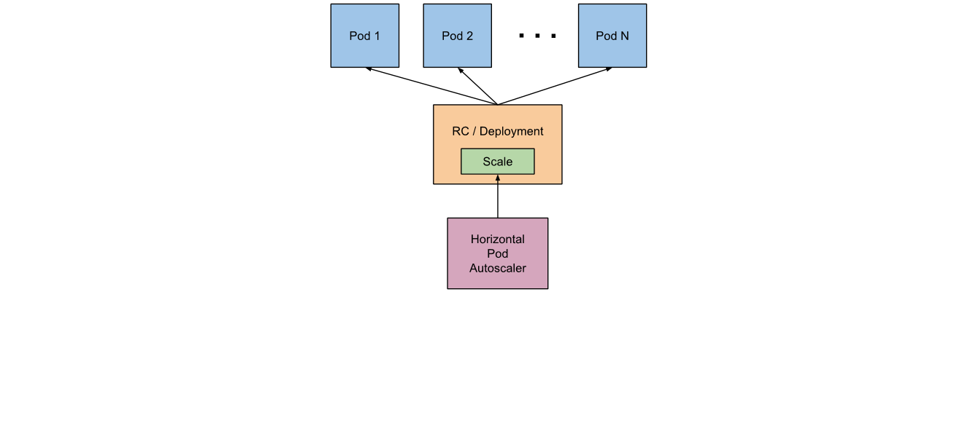
Auto Scaling
apiVersion: autoscaling/v1
kind: HorizontalPodAutoscaler
metadata:
name: php-apache
namespace: default
spec:
scaleTargetRef:
apiVersion: extensions/v1beta1
kind: Deployment
name: php-apache
minReplicas: 1
maxReplicas: 10
targetCPUUtilizationPercentage: 50
Source: kubernetes.io

Slide 101
Demo 17: Auto Scaling
Notes:
* Shoud the YAML file * Apply changes to the kuard Deployment `kubectl --namespace schojak apply -f deployment.yaml` * Add the autoscaler `kubectl --namespace schojak apply -f hpa.yaml` * Show the HPA in Dashboard and show the results * Start Ubuntu container `kubectl run --namespace=schojak --rm -ti --image ubuntu bash` * Install Apache performance test `apt-get update && apt-get install -y apache2-utils` * Run performance test `ab -v 2 -n 1000000 -c 100 http://ac038685efceb11e699720aba288c0c9-663655579.eu-west-1.elb.amazonaws.com/` * Show how it scales

Slide 102
Third Party Resources
Kubernetes allow to define custom API resources
Such resources support CRUD operations as any other Kubernetes resources
To make them do something, a custom controller handling such resources has to be deployed
Monitors the cluster for resource changes
Applies the changes when needed
Example
Provisioning of RDS databases through custom resource
http://www.devoperandi.com/kubernetes-automation-with-stackstorm-and-thirdpartyresources/

Slide 103
What is missing

Slide 104
What is missing
Security
Network policies
User and Service accounts
Federation
Helm
Kubernetes package manager
Allows easy deployment or prepackaged applications

